Slide 1
Computer Networks_22CS008
Data Link Layer
Lecture (40-42)
Prepared By Dr. Chetna
Department of Computer Science and Engineering,
Chitkara University, Punjab

Slide 2
Index
Types of Errors
Redundancy
Error Detection
Error Correction

Slide 3
Types of Errors
Errors are introduced into the binary data transmitted from the sender to the receiver due to noise during transmission. The error can be a single-bit error, multi-bit error, or burst error. Error detection methods are used to check whether the receiver has received correct data or corrupted data. And error correction is used to correct the detected errors during the transmission of data from sender to receiver.
Single bit error :-
Only one bit in the data unit has changed.
Multiple bit error :-
When more than one bits are corrupted.
Burst error :-
It means that two or more bits in the data unit has changed.

Slide 4
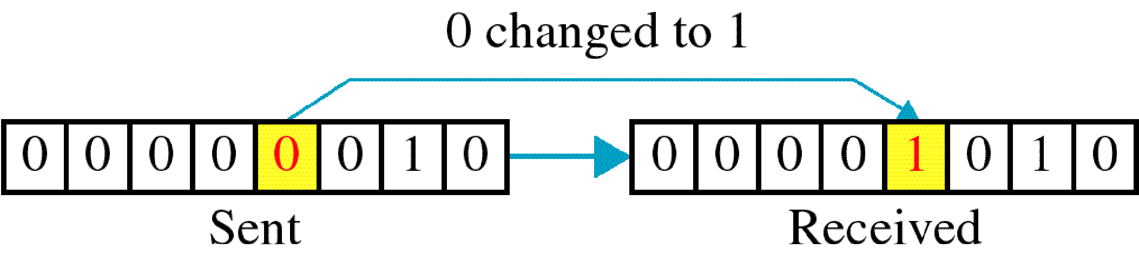
Single Bit Error
The following figure shows the Single bit error
Figure 1 Single-bit error

Slide 5
Basic concepts
Networks must be able to transfer data from one device to another with complete accuracy.
Data can be corrupted during transmission.
For reliable communication, errors must be detected and corrected.
Error detection and correction are implemented either at the data link layer or the transport layer of the OSI model.
Single bit errors are the least likely type of errors in serial data transmission because the noise must have a very short duration which is very rare. However, this kind of errors can happen in parallel transmission.
Example:
If data is sent at 1Mbps then each bit lasts only 1/1,000,000 sec. or 1μs.
For a single-bit error to occur, the noise must have a duration of only 1 μs, which is very rare.

Slide 6
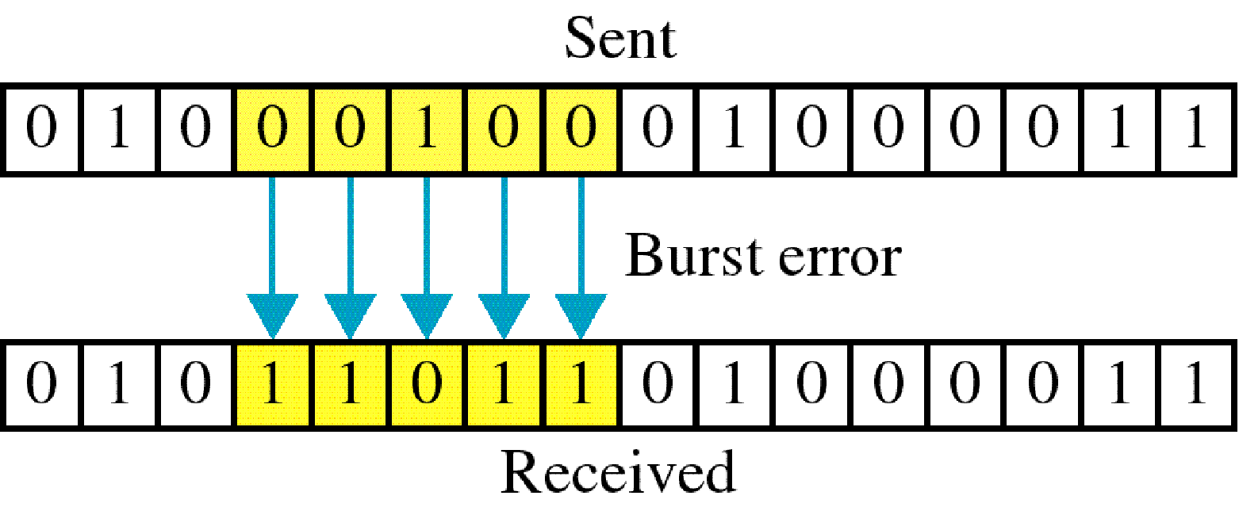
Burst Error
The following figure shows the Burst error
Figure 2 Burst error

Slide 7
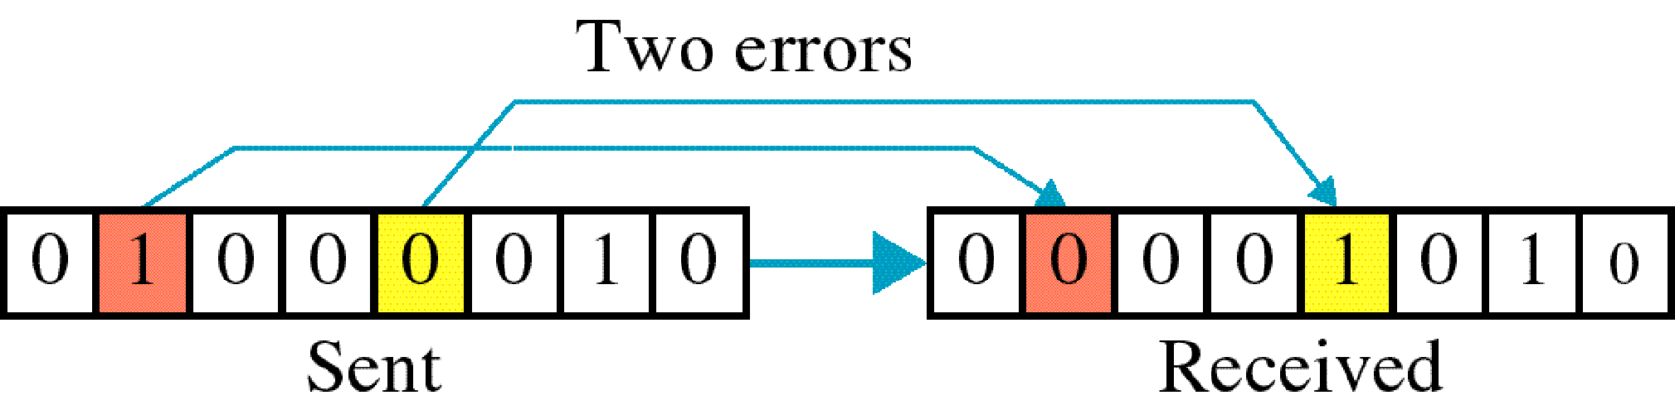
Burst Error( cont..)
Figure 3 Two errors
The term burst error means that two or more bits in the data unit have changed from 1 to 0 or from 0 to 1. Burst errors does not necessarily mean that the errors occur in consecutive bits, the length of the burst is measured from the first corrupted bit to the last corrupted bit.

Slide 8
Burst Error( cont..)
Burst error is most likely to happen in serial transmission since the duration of noise is normally longer than the duration of a bit.
The number of bits affected depends on the data rate and duration of noise.
Example:
If data is sent at rate = 1Kbps then a noise of 1/100 sec can affect 10 bits.(1/100*1000)
If same data is sent at rate = 1Mbps then a noise of 1/100 sec can affect 10,000 bits.(1/100*10⁶)

Slide 9
Error detection
Error detection means to decide whether the received data is correct or not without having a copy of the original message.
Error detection uses the concept of redundancy, which means adding extra bits for detecting errors at the destination.

Slide 10
Redundancy
Instead of repeating the entire data stream, a shorter group of bits may be appended to the end of each unit.
This technique is called Redundancy because the extra bit are redundant to the information. They are discarded as soon as the accuracy of the transmission has been determined.
There are basically four types of redundancy checks. They are:
1. VRC (Vertical Redundancy Check).
2. LRC (Longitudinal Redundancy Check).
3. CRC (Cyclical Redundancy Check).
4. Checksum

Slide 11
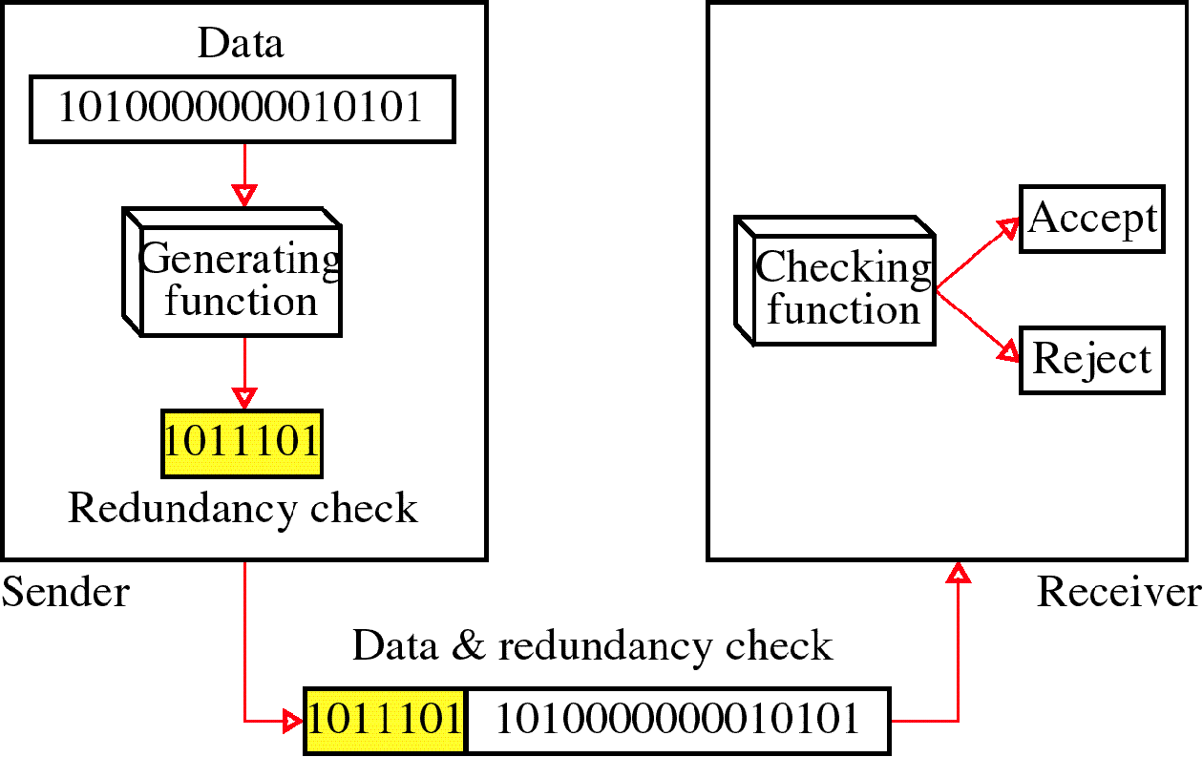
Redundancy Checks
Figure 4 Redundancy Example

Slide 12
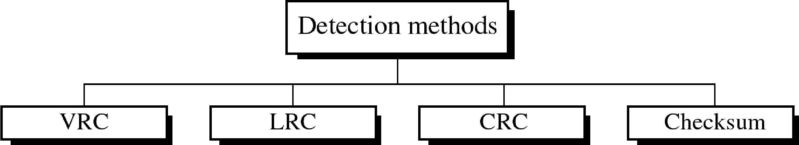
Redundancy Checks
Four types of redundancy checks are used in data communications
Figure 5 Redundancy Checks

Slide 13
Vertical Redundancy Check
It is also known as parity check
It is least expensive mechanism for error detection
In this technique, the redundant bit called parity bit is appended to every data unit so that the total number of 1s in the unit becomes even (including parity bit)

Slide 14
Vertical Redundancy Check
1100001 Data
Checking function
Is total number of 1s even ?
Even – parity generator
1100001 | 1
Receiver
1
Sender
Figure 6 Vertical Redundancy Check

Slide 15
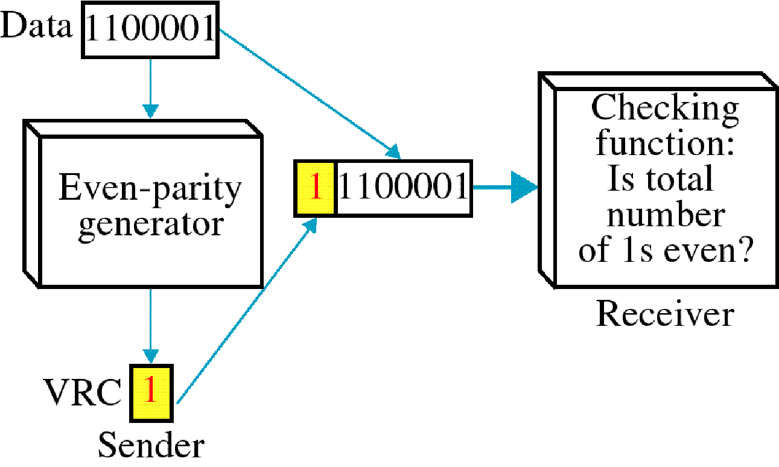
Vertical Redundancy Check (VRC)
Figure 7 Vertical Redundancy Check

Slide 16
Parity Check
Note:
In parity check, a parity bit is added to every data unit so that the total number of 1s is even (or odd for odd-parity).

Slide 17
Example 1
Suppose the sender wants to send the word world. In ASCII the five characters are coded as
1110111 1101111 1110010 1101100 1100100
The following shows the actual bits sent
11101110 11011110 11100100 11011000 11001001

Slide 18
Example 2
Now suppose the word world in Example 1 is received by the receiver without being corrupted in transmission.
11101110 11011110 11100100 11011000 11001001
The receiver counts the 1s in each character and comes up with even numbers (6, 6, 4, 4, 3). The data are accepted.

Slide 19
Example 3
Now suppose the word world in Example 1 is corrupted during transmission.
11111110 11011110 11101100 11011000 11001001
The receiver counts the 1s in each character and comes up with even and odd numbers (7, 6, 5, 4, 4). The receiver knows that the data are corrupted, discards them, and asks for retransmission.

Slide 20
LONGITUDINAL REDUNDANCY CHECK
LRC
11100111 11011101 00111001 10101001
10101001
00111001
11011101
11100111
LRC 10101010
11100111 11011101 00111001 10101001 10101010
Data plus LRC
Figure 8 Longitudinal Redundancy Check

Slide 21
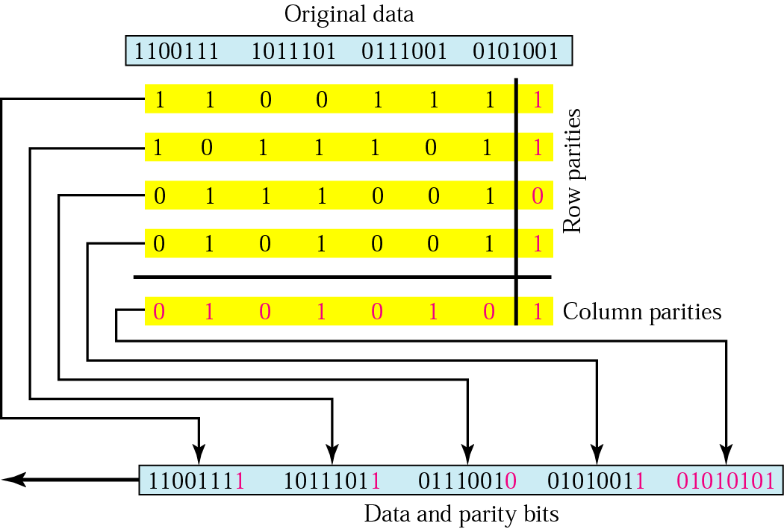
Two-dimensional parity
Figure 9 Two-dimensional parity-check code

Slide 22
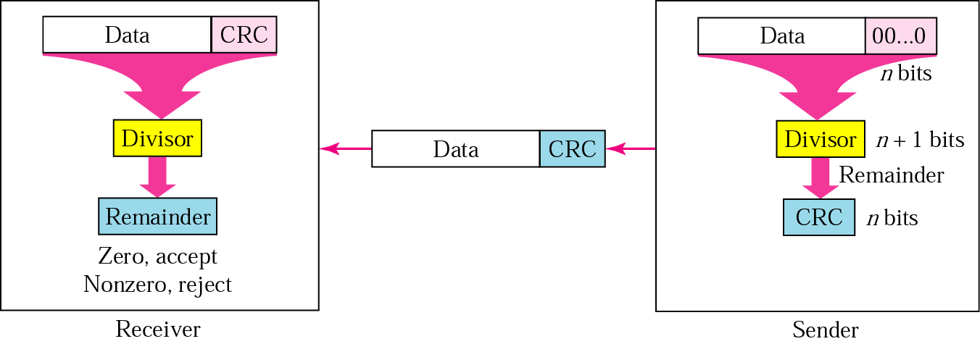
CRC generator and checker
Figure 10 CRC generator and checker

Slide 23
Sender’s steps
Note:
The sender follows these steps:
The unit is divided into k sections, each of n bits.
All sections are added using one’s complement to get the sum.
The sum is complemented and becomes the checksum.
The checksum is sent with the data.

Slide 24
Receiver’s steps
Note:
The receiver follows these steps:
The unit is divided into k sections, each of n bits.
All sections are added using one’s complement to get the sum.
The sum is complemented.
If the result is zero, the data are accepted: otherwise, rejected.

Slide 25
Example 4
Suppose the following block of 16 bits is to be sent using a checksum of 8 bits.
10101001 00111001
The numbers are added using one’s complement
10101001
00111001 ------------ Sum 11100010
Checksum 00011101
The pattern sent is 10101001 00111001 00011101

Slide 26
Example 5
Now suppose the receiver receives the pattern sent in Example 7 and there is no error.
10101001 00111001 00011101
When the receiver adds the three sections, it will get all 1s, which, after complementing, is all 0s and shows that there is no error.
10101001
00111001
00011101
Sum 11111111
Complement 00000000 means that the pattern is OK.

Slide 27
Example 6
Now suppose there is a burst error of length 5 that affects 4 bits.
10101111 11111001 00011101
When the receiver adds the three sections, it gets
10101111
11111001
00011101
Partial Sum 1 11000101
Carry 1
Sum 11000110
Complement 00111001 the pattern is corrupted.

Slide 28
Correction
Retransmission
Forward Error Correction
Burst Error Correction

Slide 29
Difference between VRC and LRC
Sr.No. | Vertical Redundancy Check (VRC) | Longitudinal Redundancy Check (LRC)
1. | It stands for Vertical Redundancy Check. | It stands for Longitudinal Redundancy Check.
2. | In this redundant bit called parity bit is added to each data unit. | In this redundant row of bits is added to the whole block.
3. | VRC can detect single bit errors. | LRC can detect burst errors.
4. | It is also known as parity checker. | It is also known as 2-D parity checker.
5. | The advantage of using VRC is that it can checks all single bit errors but can check odd parity only in the case of change of odd bits. | The advantage of using LRC over VRC is that it can check all the burst errors.
6. | It is not capable of checking the burst error in case of change of bits is even. | If two bits in data unit is damaged and also in other data unit the same bits are damaged at same position, then it is not capable of detecting such kind of error.

Slide 30
Hamming Code
Data and redundancy bits
Number of data bits m | Number of redundancy bits r | Total bits m + r
1 | 2 | 3
2 | 3 | 5
3 | 3 | 6
4 | 3 | 7
5 | 4 | 9
6 | 4 | 10
7 | 4 | 11

Slide 31
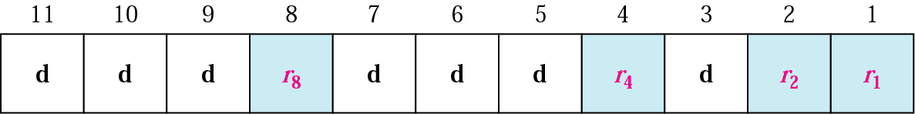
Positions of redundancy bits in Hamming code

Slide 32
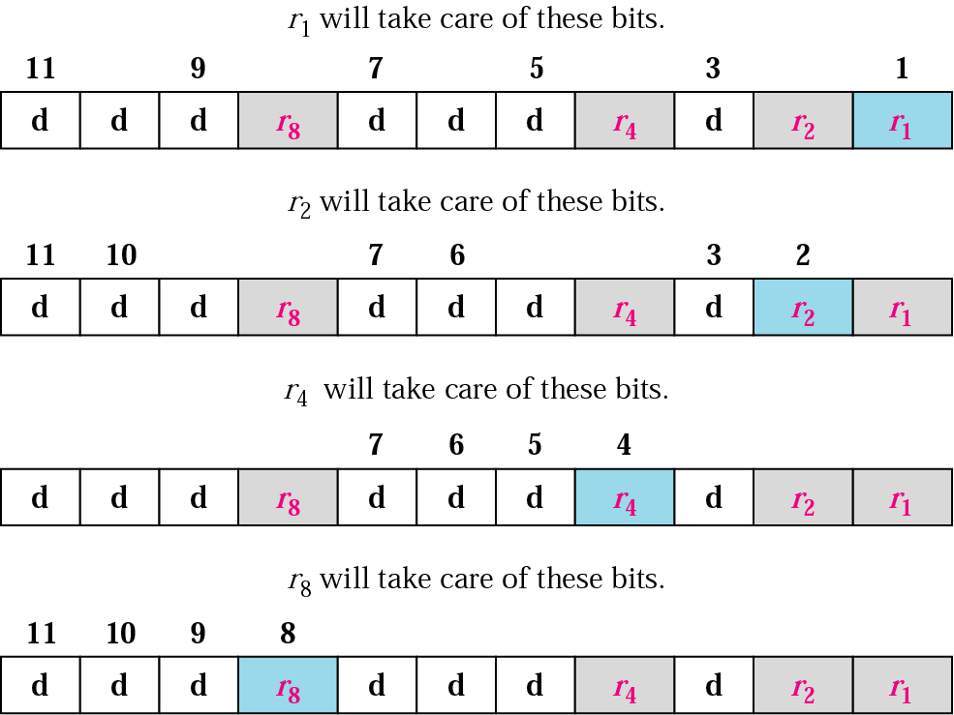
Redundancy bits calculation
Figure 11 Example of Redundancy Bit Calculation

Slide 33
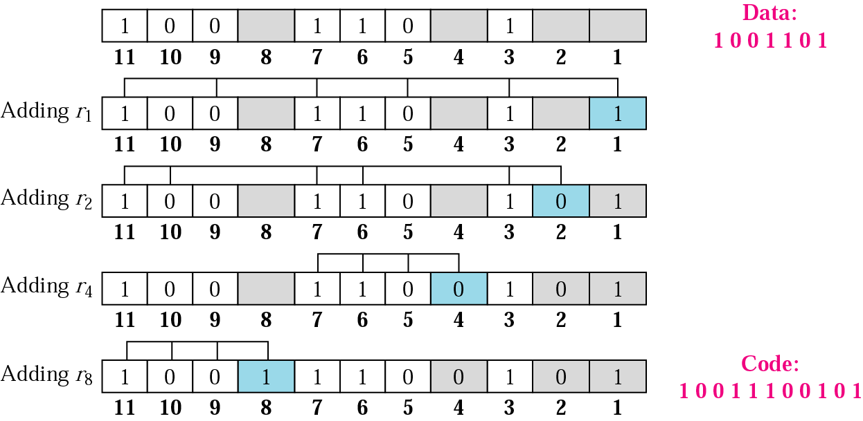
Example of redundancy bit calculation
Figure 12 Example of Redundancy Bit Calculation

Slide 34
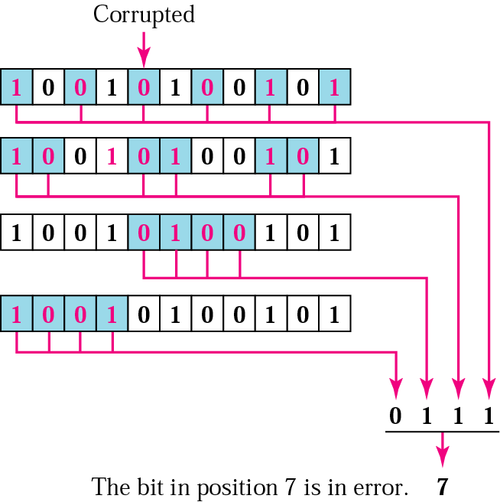
Error detection using Hamming code
Figure 13 Example of Hamming Code

Slide 35
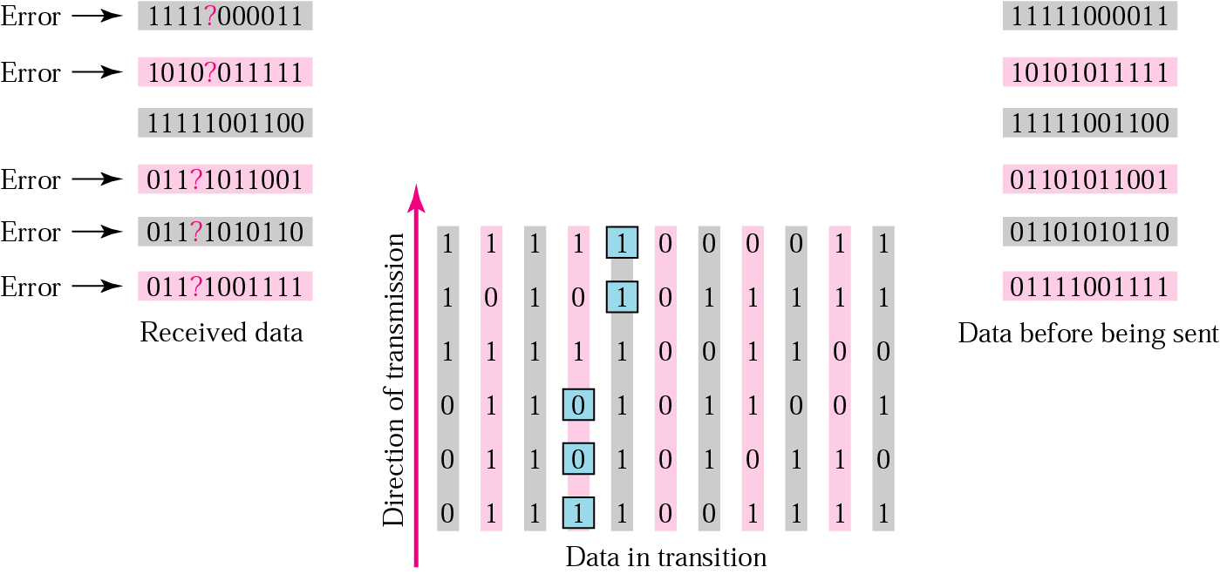
Burst error correction Example
Figure 14 Burst Error Correction Example

Slide 36
Multiple Choice Questions
What identifier is used at the data link layer to uniquely identify an Ethernet device?
IP address
MAC address
sequence number
TCP port number
UDP port number
What attribute of a NIC would place it at the data link layer of the OSI model?
attached Ethernet cable
IP address
MAC address
RJ-45 port
TCP/IP protocol stack
A technician has been asked to develop a physical topology for a network that provides a high level of redundancy. Which physical topology requires that every node is attached to every other node on the network?
bus
star
hierarchical
mesh
ring

Slide 37
Multiple Choice Questions
Which two engineering organizations define open standards and protocols that apply to the data link layer? (Choose two.)
International Organization for Standardization (ISO)
Internet Assigned Numbers Authority (IANA)
International Telecommunication Union (ITU)
Electronic Industries Alliance (EIA)
Internet Society (ISOC)
What is true concerning physical and logical topologies?
Physical topologies are concerned with how a network transfers frames.
The logical topology is always the same as the physical topology.
Physical topologies display the IP addressing scheme of each network.
Logical topologies refer to how a network transfers data between devices.
What method is used to manage contention-based access on a wireless network?
token passing
CSMA/CA
priority ordering
CSMA/CD

Slide 38
Practice Questions
https://www.netacad.com/portal/learning
https://pinoybix.org/2017/07/mcq-in-network-layer-internet-protocol-forouzan.html
https://edurev.in/course/quiz/attempt/-1_Test-Ipv4--IP-Packet/0decdb37-7206-4824-afdd-d47013a5c4cd

